Slide 1
PEL541
Lesson 6- Conjunctions

Slide 2
Objectives
The lesson will help learners to:
Learn the deviant use of conjunction
Apply the conjunctions in personal and professional communication.

Slide 3



Slide 4
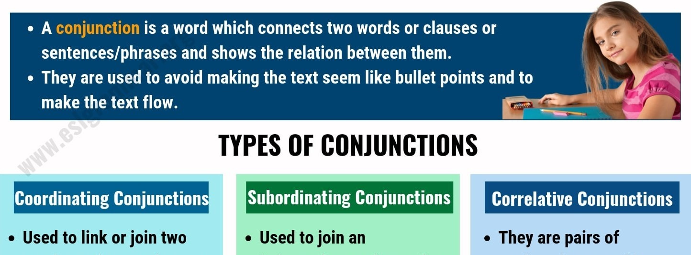
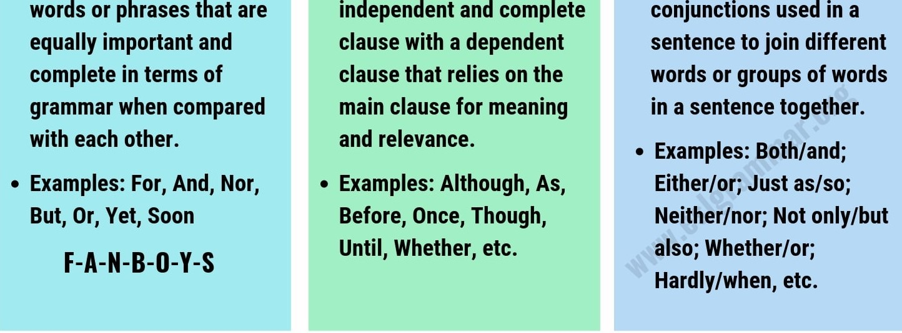

Slide 5
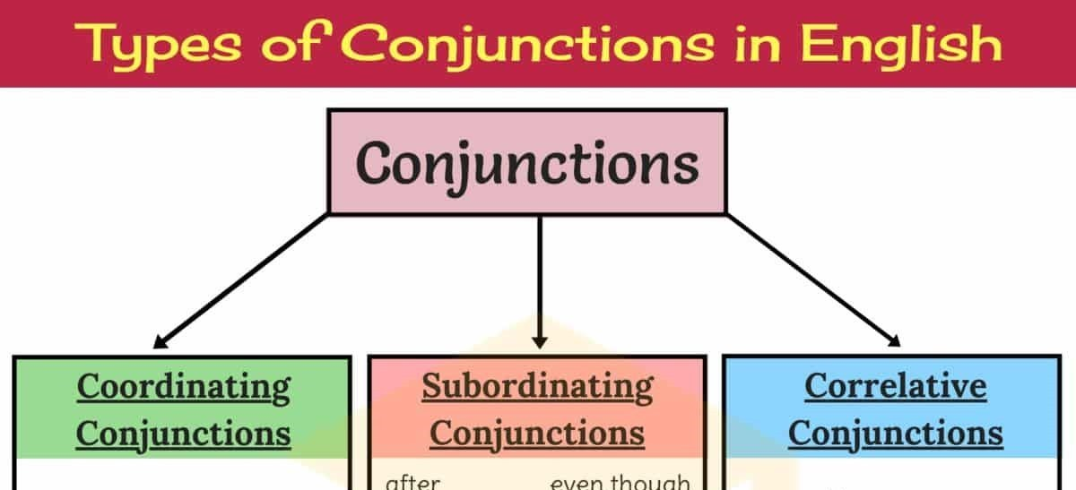
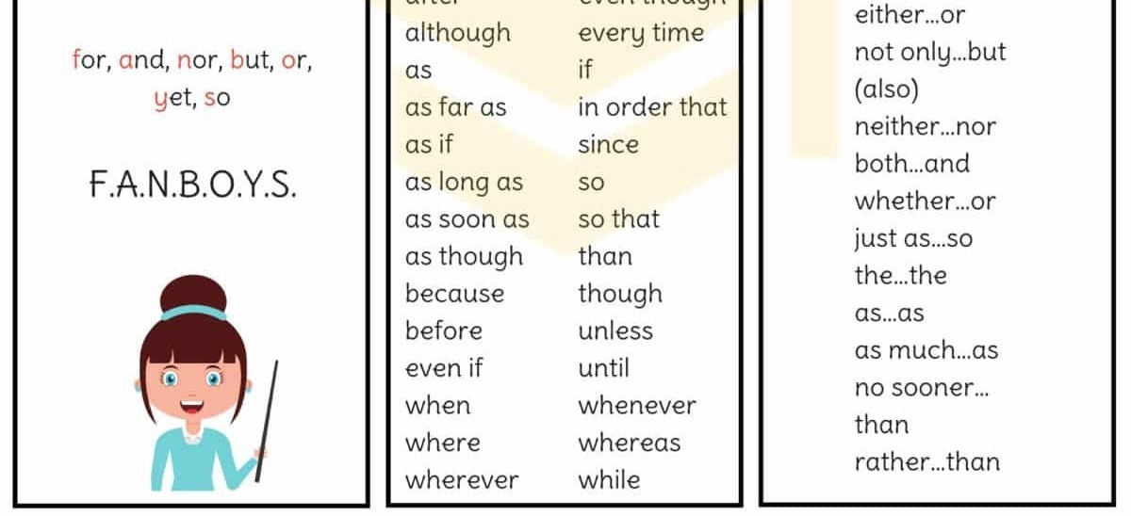

Slide 6
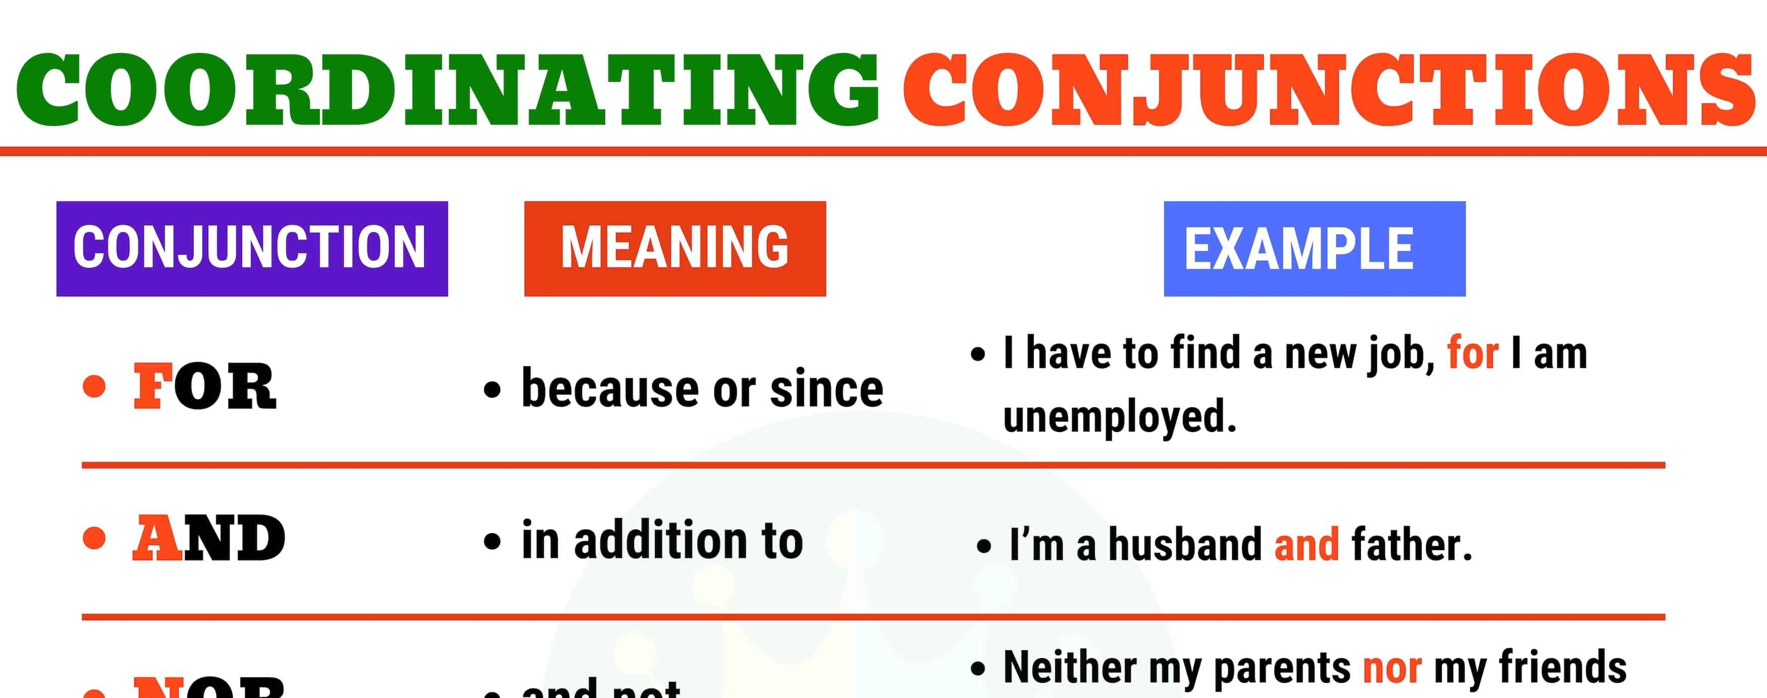
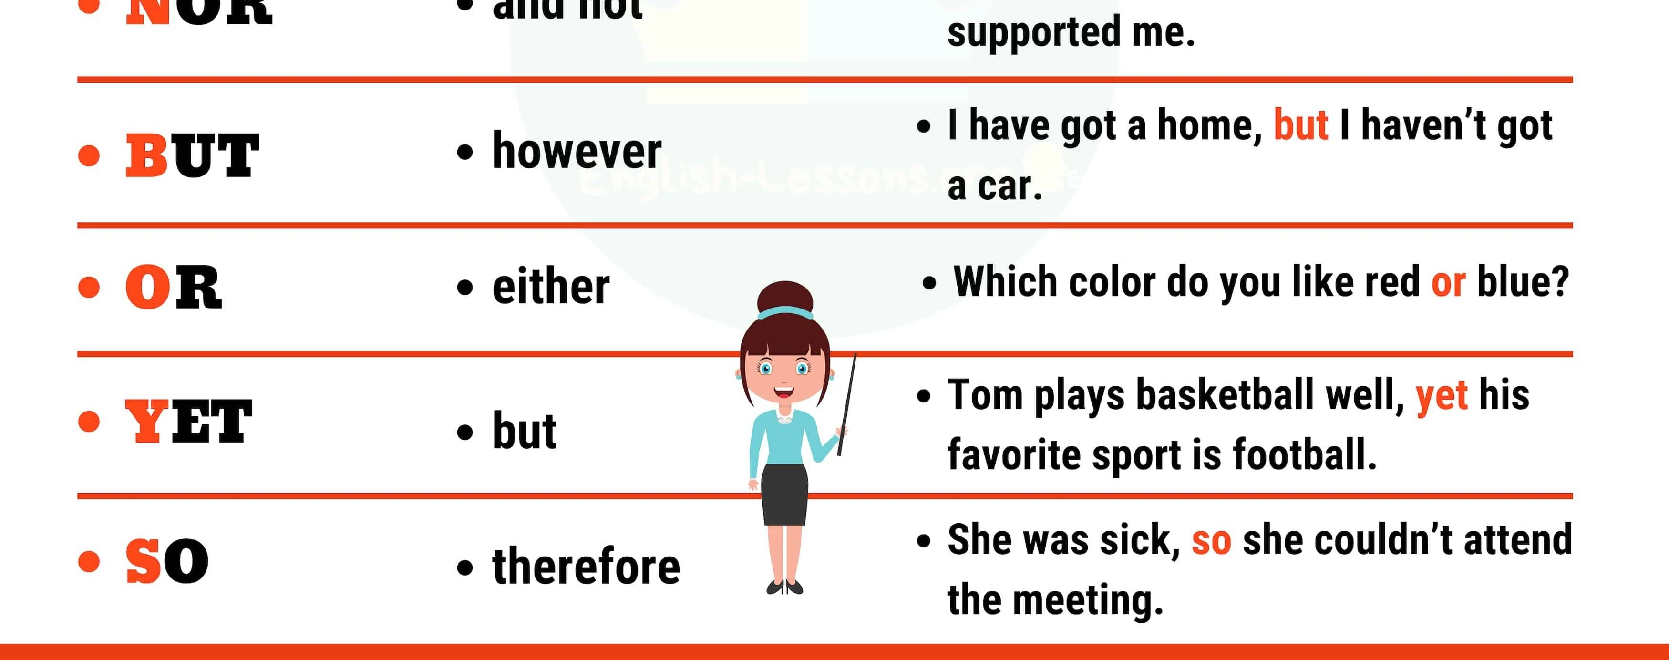

Slide 7

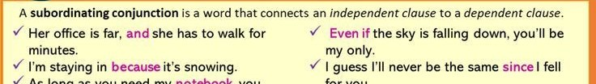
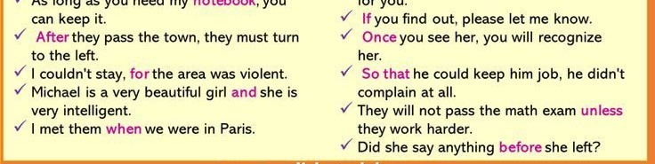

Slide 8
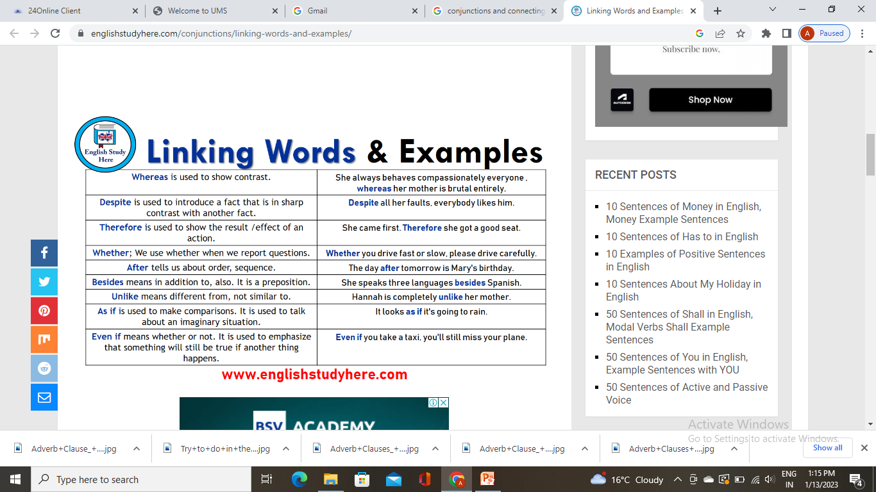

Conjunctions and connecting ideas between and within sentences

Slide 9
Cont..

Slide 10
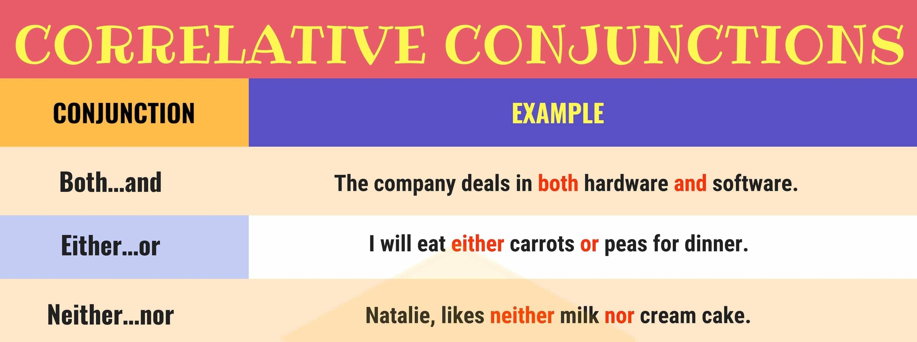
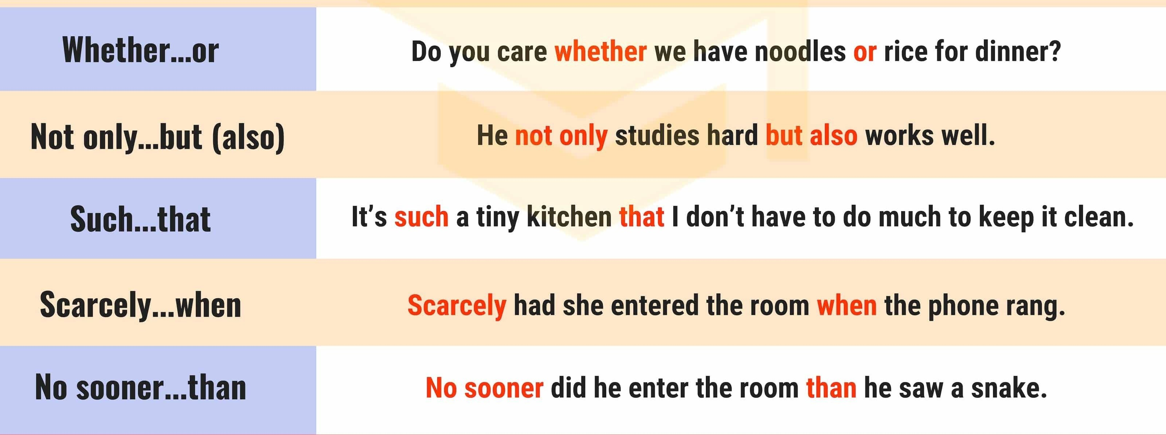

Slide 11
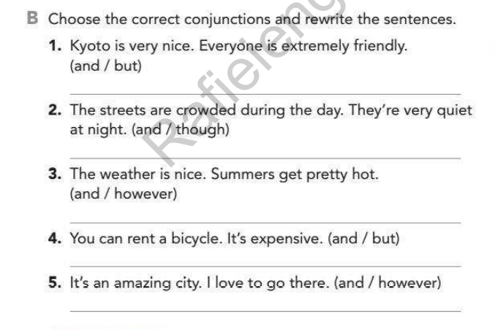

Slide 12
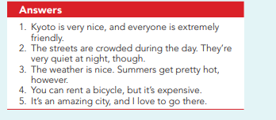

Slide 13
Exercise: Fill in the blank with correct conjunctions
1. I need to work hard I can pass the exam.
2.
he was the best candidate, he didn't win
the elections.
3.
you come back from your trip, we'll meet
to discuss the problem.
4. They said that the movie was fantastic, I watched it.
5.
he was very ill, he didn't take any
medicine.

Slide 14
Exercise: Fill in the blank with correct conjunctions
6. I don't know I can buy a pair of jeans.
7. She went to the shops couldn't find anything that could fit her needs.
8. Everybody likes him because he is nice helpful.
9.
he was angry with her, he didn't utter a
word.
10. Keep quiet go out.

Slide 15
Answers
I need to work hard so that I can pass the exam.
Although he was the best candidate, he didn't win the elections.
When you come back from your trip, we'll meet to discuss the problem.
They said that the movie was fantastic, so I watched it.
Although he was very ill, he didn't take any medicine.
I don't know where I can buy a pair of jeans.
She went to the shops but couldn't find anything that could fit her needs.
Everybody likes him because he is nice and helpful.
Since he was angry with her, he didn't utter a word.
Keep quiet or go out.

Slide 16
Exercise-Choose the best word or phrase to fill the gaps
We ate a pizza a kebab. (BUT / AND / SO)
We had some cake _ we didn’t have any coffee. (UNLESS
/ UNTIL / BUT)
I had a headache I didn’t go to the party. (WHEN / SO / WHEREAS)
You can have a coffee a tea but not both. (OR / TILL / BUT)
I can’t come to school I have an important appointment. (SO / BECAUSE / UNLESS)
I will call you I get home. (AS / AND / WHEN)
•
you do your homework, you will pass the course.
(UNLESS / UNTIL / AS LONG AS)

Slide 17
Answers
We ate a pizza and a kebab.
We had some cake but we didn’t have any coffee.
I had a headache so I didn’t go to the party.
You can have a coffee or a tea but not both.
I can’t come to school because I have an important appointment.
I will call you when I get home.
As long as you do your homework, you will pass the course

Slide 18
E-Resources
http://www.learnenglishrapidly.com/2013/10/synthesis-making-of- simplecomplexcompou.html
https://www.englishgrammar.org/synthesis-sentences/
https://webapps.towson.edu/ows/conjunctions.htm

